Slide 1
MBCHB LECTURES LEVEL V
Understanding health systems
23/05/2018
Dr. Peterson J Muriithi
School of Public Health
University of Nairobi

Slide 2
OBJECTIVE
To define the role of health system in enhancing population health
To understand the interconnectivity of the key components of health system.

Slide 3
Contents
Background
Definition and concept
Potential of health system in improving health and addressing health inequity
Functioning of a Health System
Components of Health system

Slide 4
Role of Health Systems
A well functioning health system responds in a balanced way to a population’s needs and expectations by:
improving the health status of individuals, families and communities
defending the population against what threatens its health
protecting people against the financial consequences of ill-health
providing equitable access to people-centred care
making it possible for people to participate in decisions affecting their health and health system
Source: http://www.who.int/healthsystems/EN_HSSkeycomponents.pdf?ua=1

Slide 6
Health systems concept
Defining a Health System
What is a health system?
A health system consists of all organisations, people and actions whose primary intent is to promote, restore or maintain health (WHO - http://www.who.int/features/qa/28/en/)
or,
Structured and interrelated work of all agencies contributing to health within a country
A good health system delivers quality services to all people, when and where they need them

Slide 7
Health systems concept
Health systems is therefore more than the pyramid of publicly owned facilities that deliver personal health services
It includes, private and not for profit providers; behaviour change programmes; public health legislation, vector-control campaigns; health insurance organisations; occupational health and safety legislation, community workers, health educators, researchers, patients, and consumers and even, a mother caring for a sick child at home

Slide 8
Functioning of a Health System
The way health systems are organised and managed can influence use and outcomes of health services (KN on Health Systems)
Thus Health Systems can influence the outcome of interventions.
A functioning health system is made up of several components which WHO refers to as building blocks
The multiple relationships and interactions among the blocks constitute a functioning health system (See slide #20)

Slide 9
Components of a health system
According to WHO (2007), a health system can be analysed using the following building blocks:
Leadership and governance
Health financing
Service delivery
Human resources for health (HRH)
Medical products, vaccines and technologies
Health information systems (HIS)

Slide 10
Building Blocks of Health Systems
According to WHO (2007), a health system can be analysed using the following building blocks:
Leadership and governance
Health information systems
Health financing
Human resources for health
Essential medical products and technologies
Service delivery
Source WHO, 2010
http://www.who.int/healthsystems/EN_HSSkeycomponents.pdf?ua=1

Slide 11
Building Blocks of Health Systems
Leadership and governance
Features that define good leadership and governance:
Ensuring that health authorities take responsibility for steering the entire health sector
Defining, through transparent and inclusive processes, national health policies, strategy and plan that set a clear direction for the health sector
Effective regulation through a combination of guidelines, mandates, and incentives, backed up by legal measures and enforcement mechanisms;
Effective policy dialogue with other sectors.
Mechanisms and institutional arrangements to channel donor funding and align it to country priorities.
These features are also influenced by social and political environment.
Notes:
Example on Regulatory mechanisms:
Regulation on noise pollution (both occupational and recreational); Use of personal protective devices

Slide 12
Building Blocks of Health Systems
Health information systems
Provides information on health challenges, on the broader environment in which the health system operates, and on the performance of the health system. This specifically includes timely intelligence on:
Progress in meeting health challenges and social objectives (particularly equity),
Health financing – information on financial and other barriers to health services for the poor and vulnerable
Trends and needs for HRH
Access to care and on the quality of services provided.

Slide 13
Building Blocks of Health Systems
Health financing
Health financing is a key policy instrument to improve health and reduce health inequalities.
Desirable features includes:
A system to raise sufficient funds for health fairly
A financing governance system supported by relevant legislation, financial audit and public expenditure reviews, and clear operational rules to ensure efficient use of funds

Slide 14
Building Blocks of Health Systems
Human resources for health
The health workforce is central to achieving health.
A well performing workforce is one that is responsive to the needs and expectations of people, is fair and efficient to achieve the best outcomes possible given available resources and circumstances.
Sustaining health workforce:
Focusing on: recruitment, education, training and distribution; enhancing productivity and performance; and improving retention.
Some Key features:
Arrangements for achieving sufficient numbers of the right mix
Regulatory mechanisms to ensure system wide deployment and distribution in accordance with needs
Establishment of job related norms, deployment of support systems and enabling work environments
Mechanisms to ensure cooperation of all stakeholders

Slide 15
Building Blocks of Health Systems
Essential medical products and technologies
Health care is heavily dependent on access to affordable essential medicines, vaccines, diagnostics and health technologies of assured quality, which are used in a scientifically sound and cost-effective way
Vaccines has major role in primary prevention of hearing impairment
Notes:
Examples:
immunizing children against childhood diseases, including measles, meningitis, rubella and mumps;
immunizing adolescent girls and women of reproductive age against rubella before pregnancy
screening for and treating syphilis and other infections in pregnant women;
avoiding the use of ototoxic drugs, unless prescribed and monitored by a qualified physician;

Slide 16
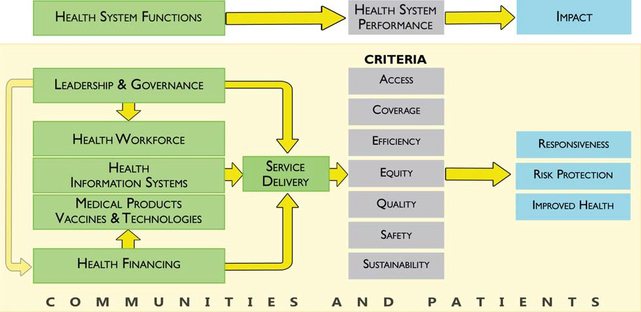
Health Systems Building Blocks Interactions

Slide 17
PRACTICUM
Focus of Analysis HS
What services are available in the county?
What support mechanisms in terms of:
Governance & leadership
Available personnel
Health information systems
Health financing
Essential medical products and technologies

Slide 18
References
WHO. 2010. Available: http://www.who.int/healthsystems/EN_HSSkeycomponents.pdf?ua=1 [Accessed March, 2010.
Kenya Constitution 2010

Slide 19
Thank you
For your attention

